Slide 1
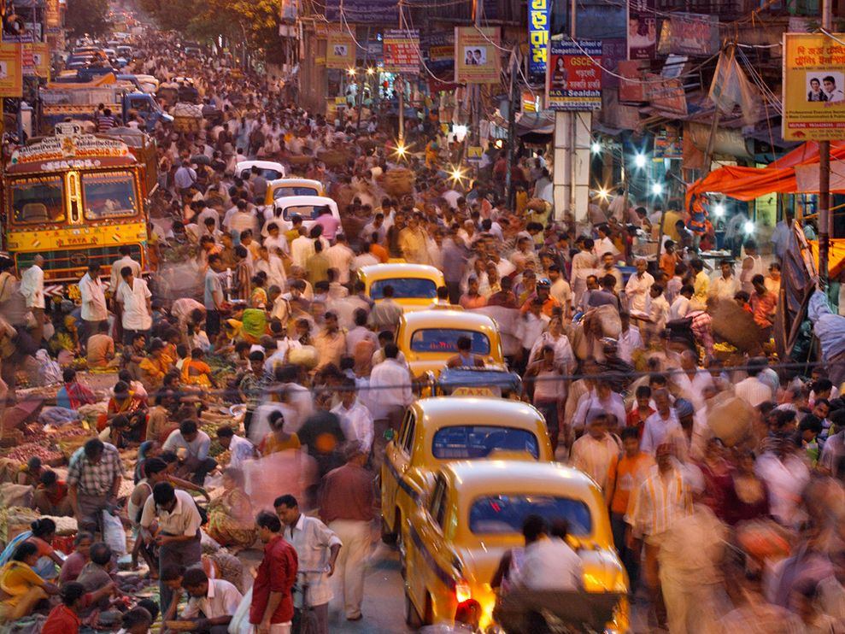
Object Detection Using Convolutional Neural Networks
LOKAVARAPU SATISH KUMAR
UBBANA RAKESH
YARRAGUNTA VAMSI KRISHNA

Slide 2
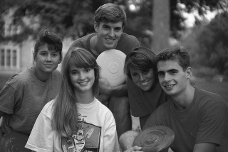
Object Detection
Task
Given an input image,
determine if there are
objects of a given class (e.g.
faces, people, cars..)
in the image and where they are located.

Slide 3

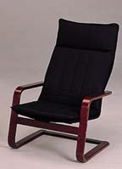
Detection—Challenges
Classifier must generalize over all exemplars of one class.
High accuracy (small FP rate) required for most applications.

Slide 4
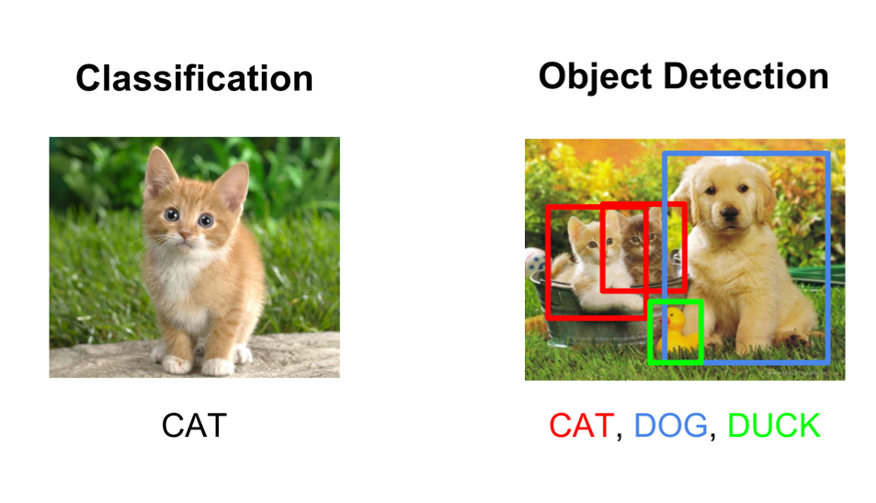
Object Detection as Classification
Object Detection specifies the location of multiple objects in the image
Image Classification helps us to classify what is contained in an image

Slide 5
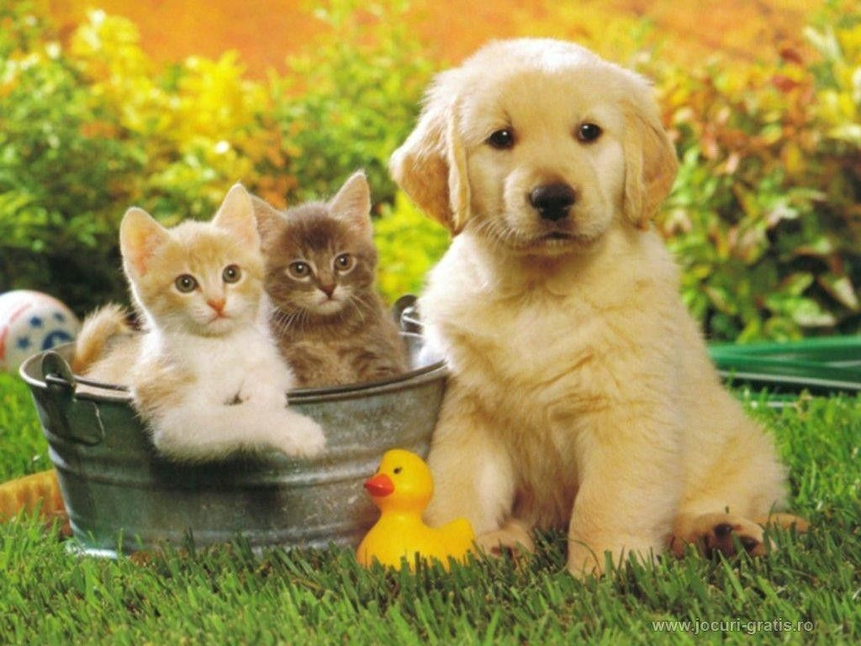
Object Detection as Classification
Classes = [cat, dog, duck]
Cat ? NO Dog ? NO Duck? NO

Slide 6
Object Detection as Classification
Classes = [cat, dog, duck]
Cat ? NO Dog ? NO Duck? NO

Slide 7
Object Detection as Classification
Classes = [cat, dog, duck]
Cat ? YES
Dog ? NO Duck? NO

Slide 8
Object Detection as Classification
Problem:
Too many positions & scales to test
Solution: Choose a classifier that is fast enough

Slide 9
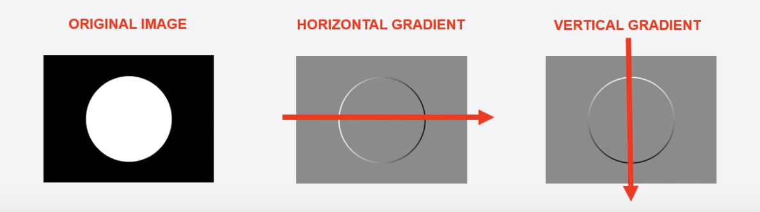
Object Detection using HOG
The H.O.G(Histogram of Oriented Gradients) is a feature descriptor used in computer vision for image processing for the purpose of object detection.
“what are gradients in this context “ ?
Take the following image for example:
Notes:
A feature descriptor is an algorithm which takes an image and outputs feature vectors.
When you step from left to right pixel by pixel, you will find that after some steps, there is a sudden change in the pixel value i.e, from a black lower pixel number to a white higher pixel number. This sudden change in the color is called a gradient and going from a darker tone to a lighter tone is called a positive gradient and vice versa. Going from left to right gives us the horizontal gradient and as expected going from top to down gives a vertical gradient.

Slide 10
How the H.O.G works
HOG works on grayscale images.
1 — So the first step would be to convert an RGB image to grayscale.
2 —horizontal and vertical gradients are calculated.
3 — Once we get the gradients we try to calculate something called gradient magnitude and gradient angle and we try to plot a histogram of magnitudes and angles.
4 — And by plotting the HOG features we will find that the structure of the object or face is well maintained, losing all the insignificant features. And such input can be leveraged by any Machine Learning algorithm (linear SVM) to do the classification or regression.
Notes:
Linear SVM is the newest extremely fast machine learning (data mining) algorithm for solving multiclass classification problems from ultra large data sets that implements an original proprietary version of a cutting plane algorithm for designing a linear support vector machine.

Slide 11
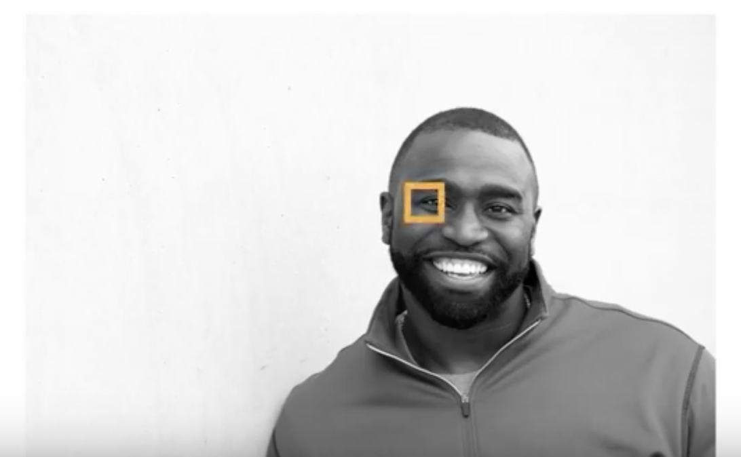
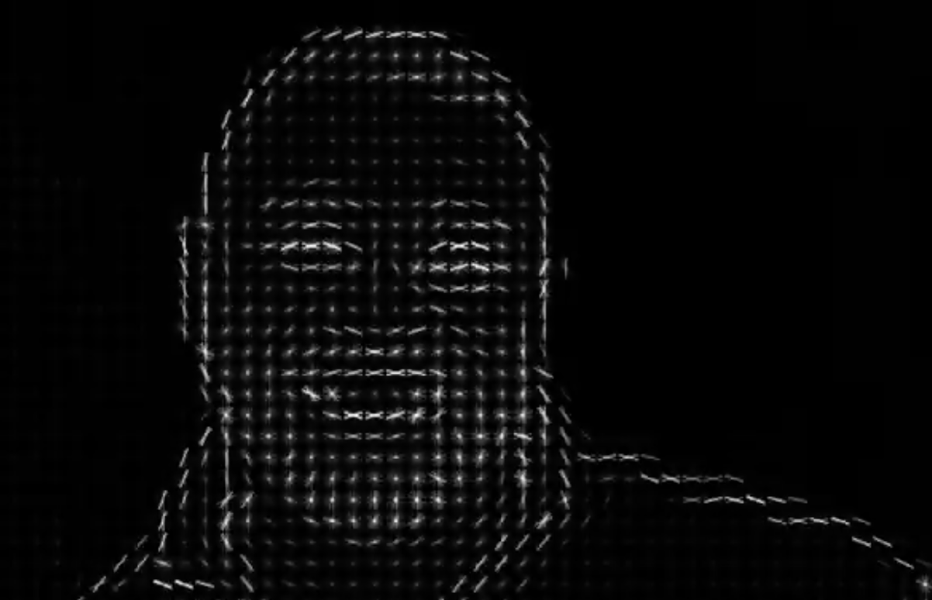
INPUT
OUTPUT

Slide 12
Problem:
HOG shows good performance for object detection. However, it has a disadvantage that is very sensitive to image rotation. Therefore, HOG is not good choice for classification of textures or objects which can often be detected as rotated image.
Solution: Convolutional Neural Networks

Slide 13

Convolutional Neural Networks
A convolutional neural network (CNN) is a type of artificial neural network used in image recognition and processing that is specifically designed to process pixel data.

Slide 14
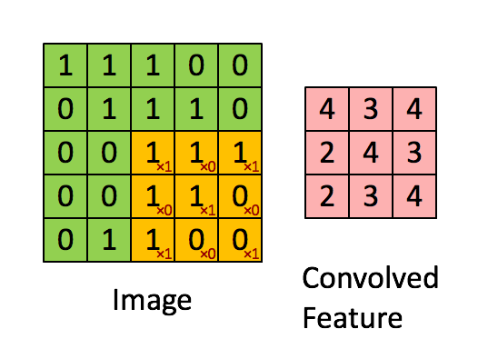
Convolution Layer — The Kernel
The objective of the Convolution Operation is to extract the high-level features from the input image.
In demonstration, the green section resembles 5x5 input image, I. The element involved in carrying out the convolution operation in the first part of a Convolutional Layer is called the Kernel/Filter, K, represented in the color yellow. We have selected K as a 3x3 matrix.

Slide 15

Rectified Linear Unit (ReLU)
ReLU is the max function(x,0) with input x e.g. matrix from a convolved image. ReLU then sets all negative values in the matrix x to zero and all other values are kept constant. ReLU is computed after the convolution.
ReLU layers able the network to train a lot faster (because of the computational efficiency) without making a significant difference to the accuracy.

Slide 16

Pooling Layer
Similar to the Convolutional Layer, the Pooling layer is responsible for reducing the spatial size of the Convolved Feature. This is to decrease the computational power required to process the data through dimensionality reduction.
3x3 pooling over 5x5 convolved feature

Slide 17

Types of Pooling
There are two types of Pooling: Max Pooling and Average Pooling. Max Pooling returns the maximum value from the portion of the image covered by the Kernel. On the other hand, Average Pooling returns the average of all the values from the portion of the image covered by the Kernel.
Notes:
Max Pooling also performs as a Noise Suppressant. It discards the noisy activations altogether and also performs de-noising along with dimensionality reduction. On the other hand, Average Pooling simply performs dimensionality reduction as a noise suppressing mechanism. Hence, we can say that Max Pooling performs a lot better than Average Pooling.

Slide 18
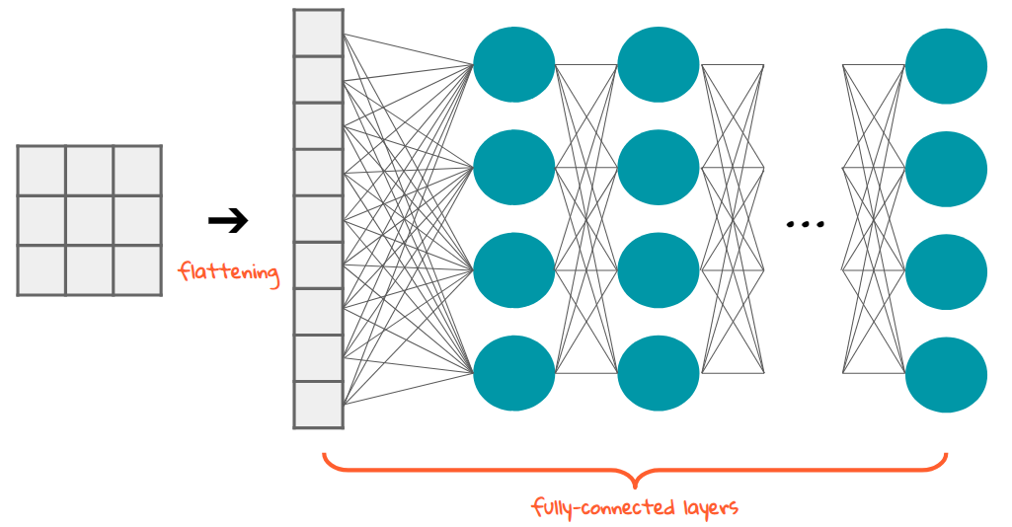
FLATTENING
Flattening is converting the data into a 1-dimensional array for inputting it to the next layer. We flatten the output of the convolutional layers to create a single long feature vector. Rectangular or cubic shapes can’t be direct inputs. And it is connected to the final classification model, which is called a fully-connected layer. In other words, we put all the pixel data in one line and make connections with the final layer

Slide 19
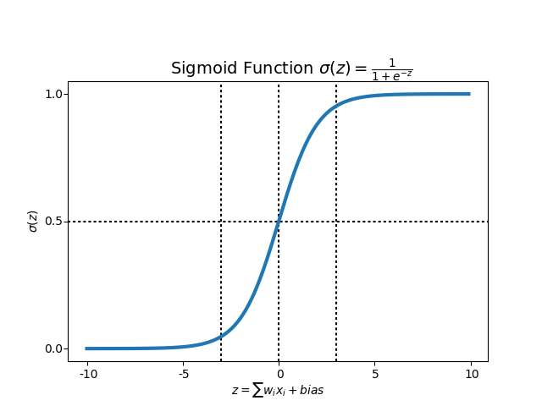
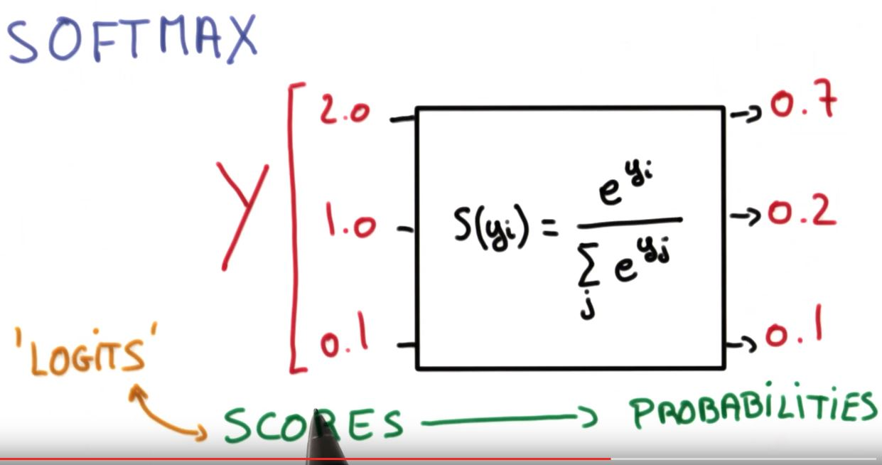
Classification — Fully Connected Layer (FC Layer)
Adding multiple convolutional layers and pooling layers, the image will be processed for feature extraction. And there will be fully connected layers heading to the layer for SoftMax (for a multi-class case) or sigmoid (for a binary case) function.
Notes:
Activation functions are mathematical equations that determine the output of a neural network. The function is attached to each neuron in the network, and determines whether it should be activated (“fired”) or not, based on whether each neuron's input is relevant for the model's prediction

Slide 20
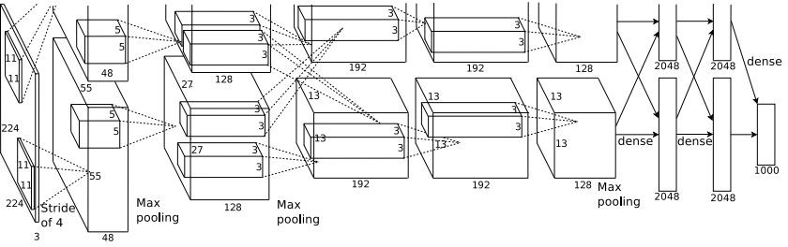
Object Detection with CNNs?

Slide 21
Object Detection with CNNs: R-CNN
The difference between object detection algorithms and classification algorithms is that in detection algorithms, we try to draw a bounding box around the object of interest to locate it within the image. Also, you might not necessarily draw just one bounding box in an object detection case, there could be many bounding boxes representing different objects of interest within the image and you would not know how many beforehand. The major reason why you cannot proceed with this problem by building a standard convolutional network followed by a fully connected layer is that, the length of the output layer is variable — not constant, this is because the number of occurrences of the objects of interest is not fixed. Hence, you would have to select a huge number of regions and this could computationally blow up. Therefore, algorithms like R-CNN have been developed to find these occurrences and find them fast.

Slide 22
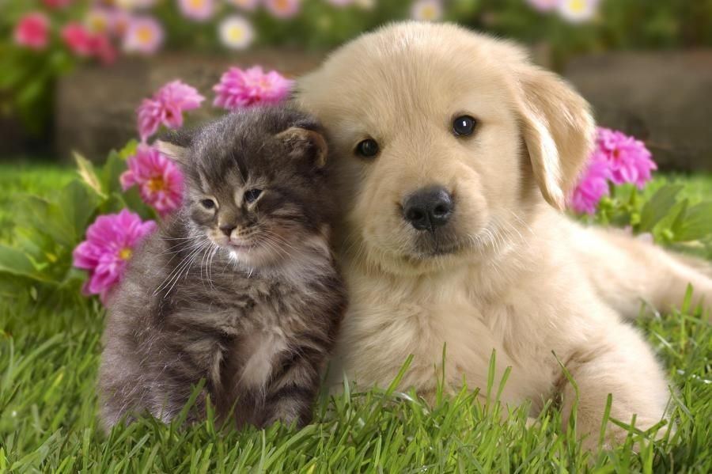
R-CNN
To bypass the problem of selecting a huge number of regions, Ross Girshick et al. proposed a method where we use selective search to extract just 2000 regions from the image and he called them region proposals (image regions that are likely to contain objects).Therefore, now, instead of trying to classify a huge number of regions, you can just work with 2000 regions.

Slide 23
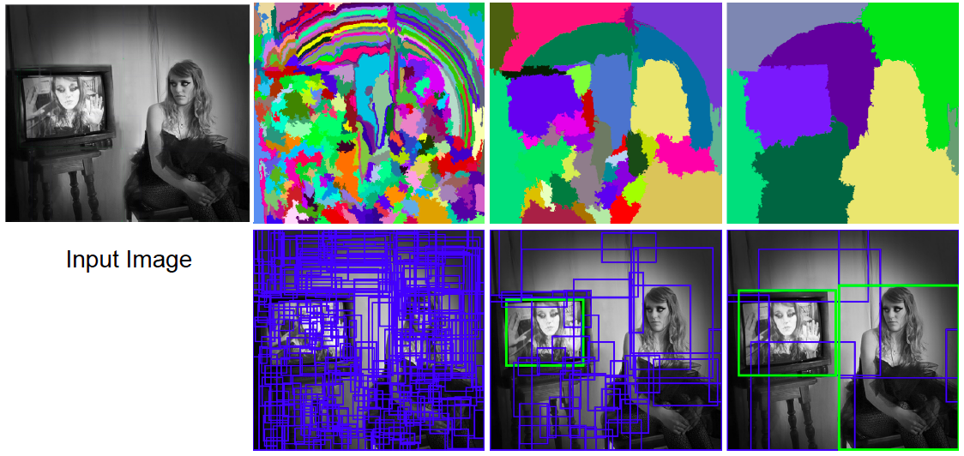
Selective search
Use hierarchical segmentation: start with small super pixels and merge based on diverse cues

Slide 24
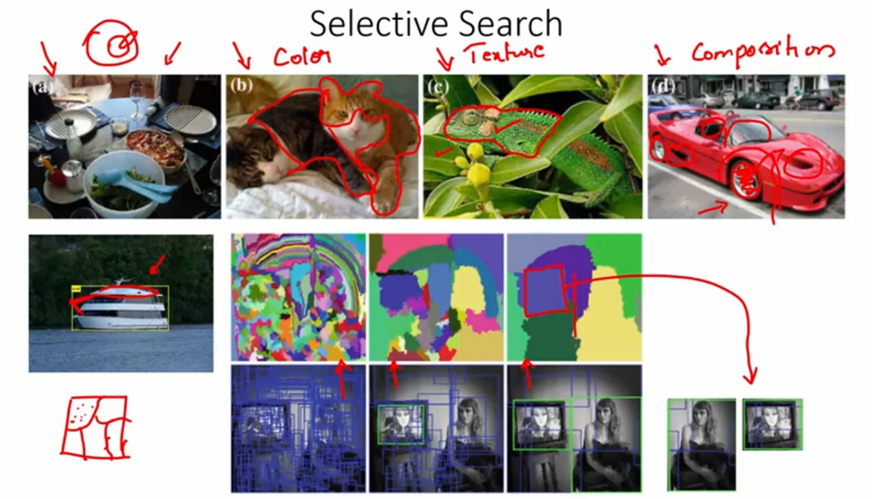

Slide 25
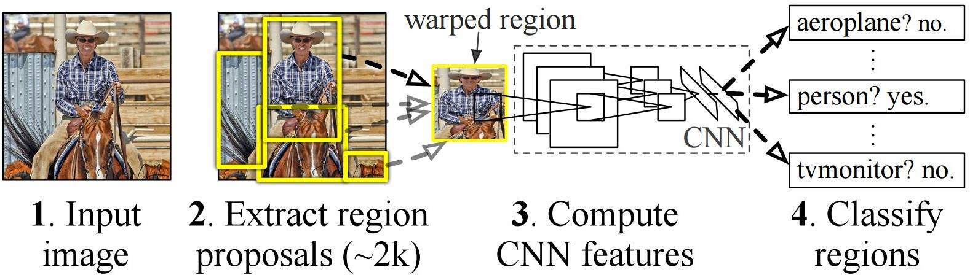
Object Detection with CNNs: R-CNN
There are 3 important parts of R-CNN:
1. Run Selective Search to generate probable objects.
2. Feed these patches to CNN, followed by SVM to predict the class of each patch.
3. Optimize patches by training bounding box regression separately.

Slide 26
R-CNN: Problem
Slow at test-time: need to run full forward pass of CNN for each region proposal
Solution: Faster R-CNN

Slide 27
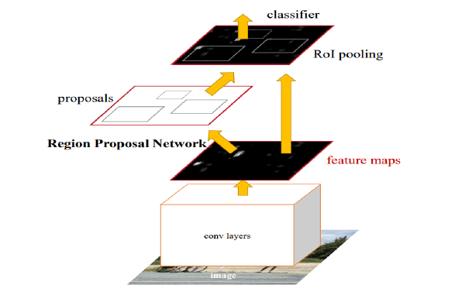
Faster R-CNN
Faster R-CNN is an object detection framework based on deep convolutional net-
works, which includes a Region Proposal Network (RPN) and an Object Detection
Network. It is based on R-CNN which uses a multi-phased approach to object de-
tection. R-CNN used Selective search to determine region proposals, pushes these
through a classification network and then uses an SVM to classify the different
regions. Instead of using default bounding boxes, Faster R-CNN has a Region Proposal Network
(RPN) to generate a set of regions. The RPN is implemented as a fully convolutional network that predicts object
bounds and objectness scores at each position.

Slide 28
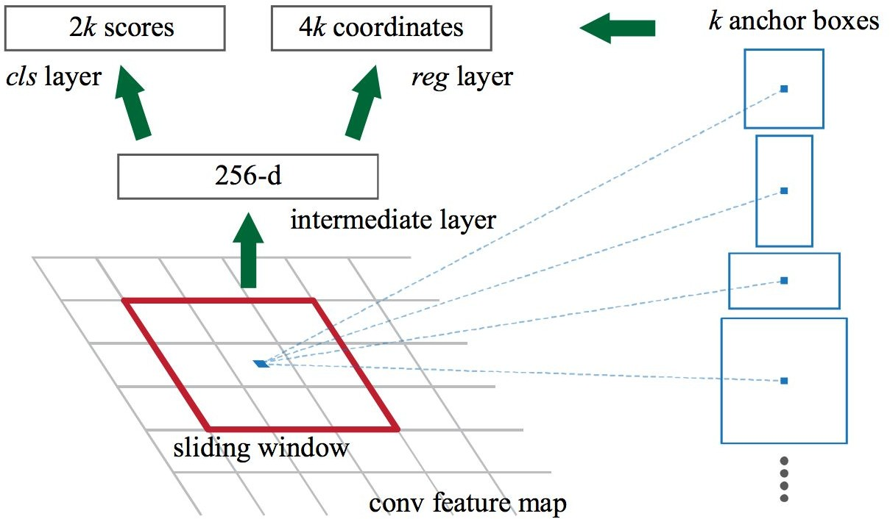
Region Proposal Network :
A Region Proposal Network (RPN) takes an image (of any size) as input and out-
puts a set of rectangular object proposals, each with an objectness score. The
RPN network works with sliding windows across the feature maps. At each sliding-
window location or anchor, a set of proposals are computed with various scales and
aspect ratios. The outcome of the RPN are adjusted bounding boxes, based on the
anchors.
The different components are combined in a single setup and are trained either
end-to-end or in multiple phases (to improve stability). Another interpretation of
the RPN is that it guides the networks attention to interesting regions.

Slide 29
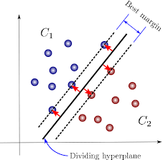
Non-maximum suppression(NMS):
Anchor Boxes :
At each sliding-window location, we simultaneously predict k region proposals, so
the reg layer has 4k outputs encoding the coordinates of k boxes. The cls layer
outputs 2k scores that estimate probability of object / not-object for each proposal.
The k proposals are parameterized relative to k reference boxes, called anchors.
Each anchor is centered at the sliding window in question, and is associated with a
scale and aspect ratio.
The general idea of non-maximum suppression is to reduce the number of detections
in a frame to the actual number of objects present. If the object in the frame is
fairly large and more than 2000 object proposals have been generated, it is quite
likely that some of these will have significant overlap with each other and the object.
Support vector machines(SVM):
A best suitable hyperplane is constructed between 2 classes which
describes the class on which the new object will lie.
Notes:
Support Vector Machines (SVMs) have their roots in Statistical Learning Theory.
They are binary classiers. The two approaches commonly used are the One-
Against-One (1A1) and One-Against-All (1AA) techniques. Here, only border or
support vector points are considered important for classication and other points
can be ignored.

Slide 30
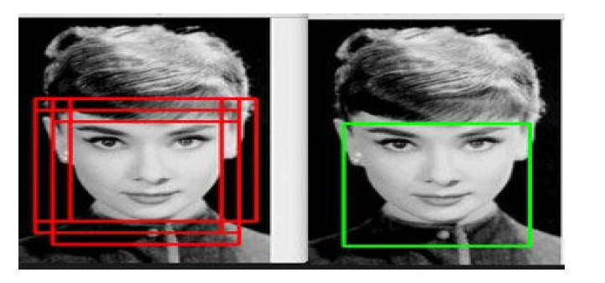
An example of NMS in the context of face detection

Slide 31
Faster R-CNN
 | R-CNN | Faster R-CNN
Test time per image (with proposals) | 50 seconds | 0.2 seconds
(Speedup) | 1x | 250x
mAP (VOC 2007) | 66.0 | 66.9

Slide 32
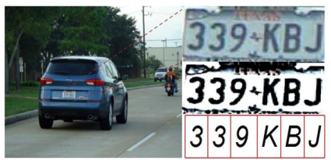
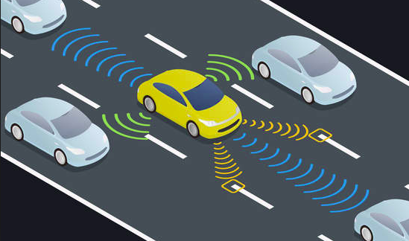
Applications Of Object Detection
OPTICAL CHARACTER RECOGNITION
SELF DRIVING CARS
Notes:
Optical character recognition or optical character reader, often abbreviated as OCR, is the mechanical or electronic conversion of images of typed, handwritten or printed text into machine-encoded text, whether from a scanned document, a photo of a document, a scene-photo (for example the text on signs and billboards in a landscape photo) or from subtitle text superimposed on an image, we are extracting characters from the image or video.
One of the best examples of why you need object detection is for autonomous driving is In order for a car to decide what to do in next step whether accelerate, apply brakes or turn, it needs to know where all the objects are around the car and what those objects are That requires object detection and we would essentially train the car to detect known set of objects such as cars, pedestrians, traffic lights, road signs, bicycles,motorcycles, etc.

Slide 33
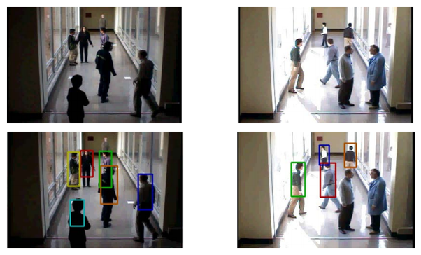
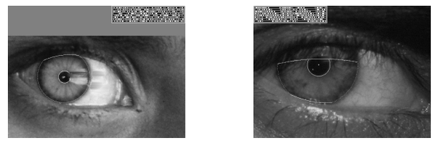
Applications Of Object Detection
3. TRACKING OBJECTS
4. IDENTITY VERIFICATION
Notes:
Object detection system is also used in tracking the objects, for example tracking a ball during a football match, tracking movement of a cricket bat, tracking a person in a video.
Object tracking has a variety of uses, some of which are surveillance and security, traffic monitoring, video communication, robot vision and animation.
Iris recognition is one of the most accurate identity verification systems. Identity verification and identification is becoming increasingly popular. However, advances in the field have expanded the options to include biometrics such as iris, retina and more. Among the large set of options it has been shown that the iris is the most accurate biometric. Hence we need object detection system in iris detection.

Slide 34
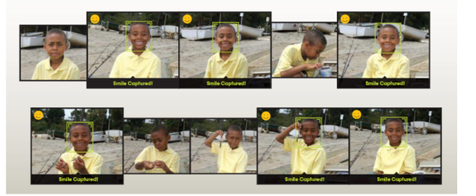
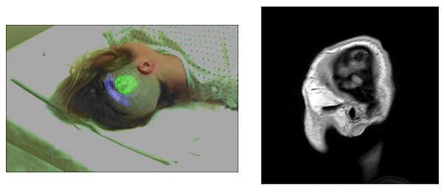
Applications Of Object Detection
5. SMILE DETECTION
6. MEDICAL IMAGING
Notes:
Facial expression analysis plays a key role in analyzing emotions and human behaviors. Smile detection is a special task in facial expression analysis with various potential applications such as photo selection, user experience analysis and patient monitoring
Medical image processing tools are playing an increasingly important role in assisting the clinicians in diagnosis, therapy planning and image-guided interventions. Accurate, robust and fast tracking of deformable anatomical objects such as the heart, is a crucial task in medical image analysis.

Slide 35
Summary
We have discovered a gentle introduction to the problem of object detection and state-of-the-art deep learning models designed to address it.
Specifically, we learned:
Object detection is refers to a collection of related tasks for identifying objects in digital photographs.
Region-Based Convolutional Neural Networks, or R-CNNs, are a family of techniques for addressing object localization and designed for model performance.

Slide 36
Resources
Related Lecture from CS231n @ Stanford [slides][video]
Images used in the PPT are borrowed from the papers
Slides for
R-CNN
Faster R-CNN [matlab][python]

Slide 37
THANK YOU

